Slide 1
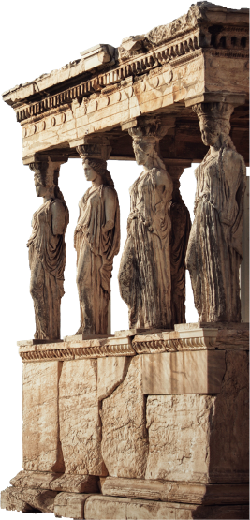
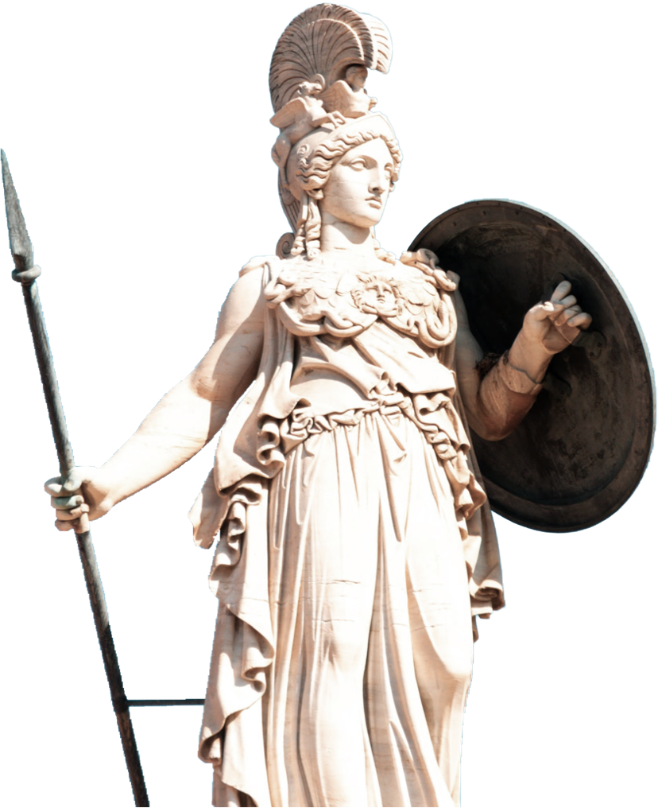
Forts and Monuments of
India

Slide 2
This is our team.
Aaradhya Kanade
Aaryan Kamdar
Alok Pal
Aniket Prasad
Ayudh Tirlotkar
Darshan Purohit
Dhairya Shukla
Harsh Redasani

Slide 3
Exploring the Rich Cultural Heritage
Welcome to the captivating journey of 'Forts and Monuments of India: Exploring the Rich Cultural Heritage.' India, with its diverse history and traditions, is a treasure trove of architectural marvels that narrate tales of empires, battles, and artistic brilliance. In this presentation, we embark on a virtual tour into the soul of India's cultural legacy,discovering the stories etched in stone and the echoes of the past resonating through these timeless structures.

Slide 4
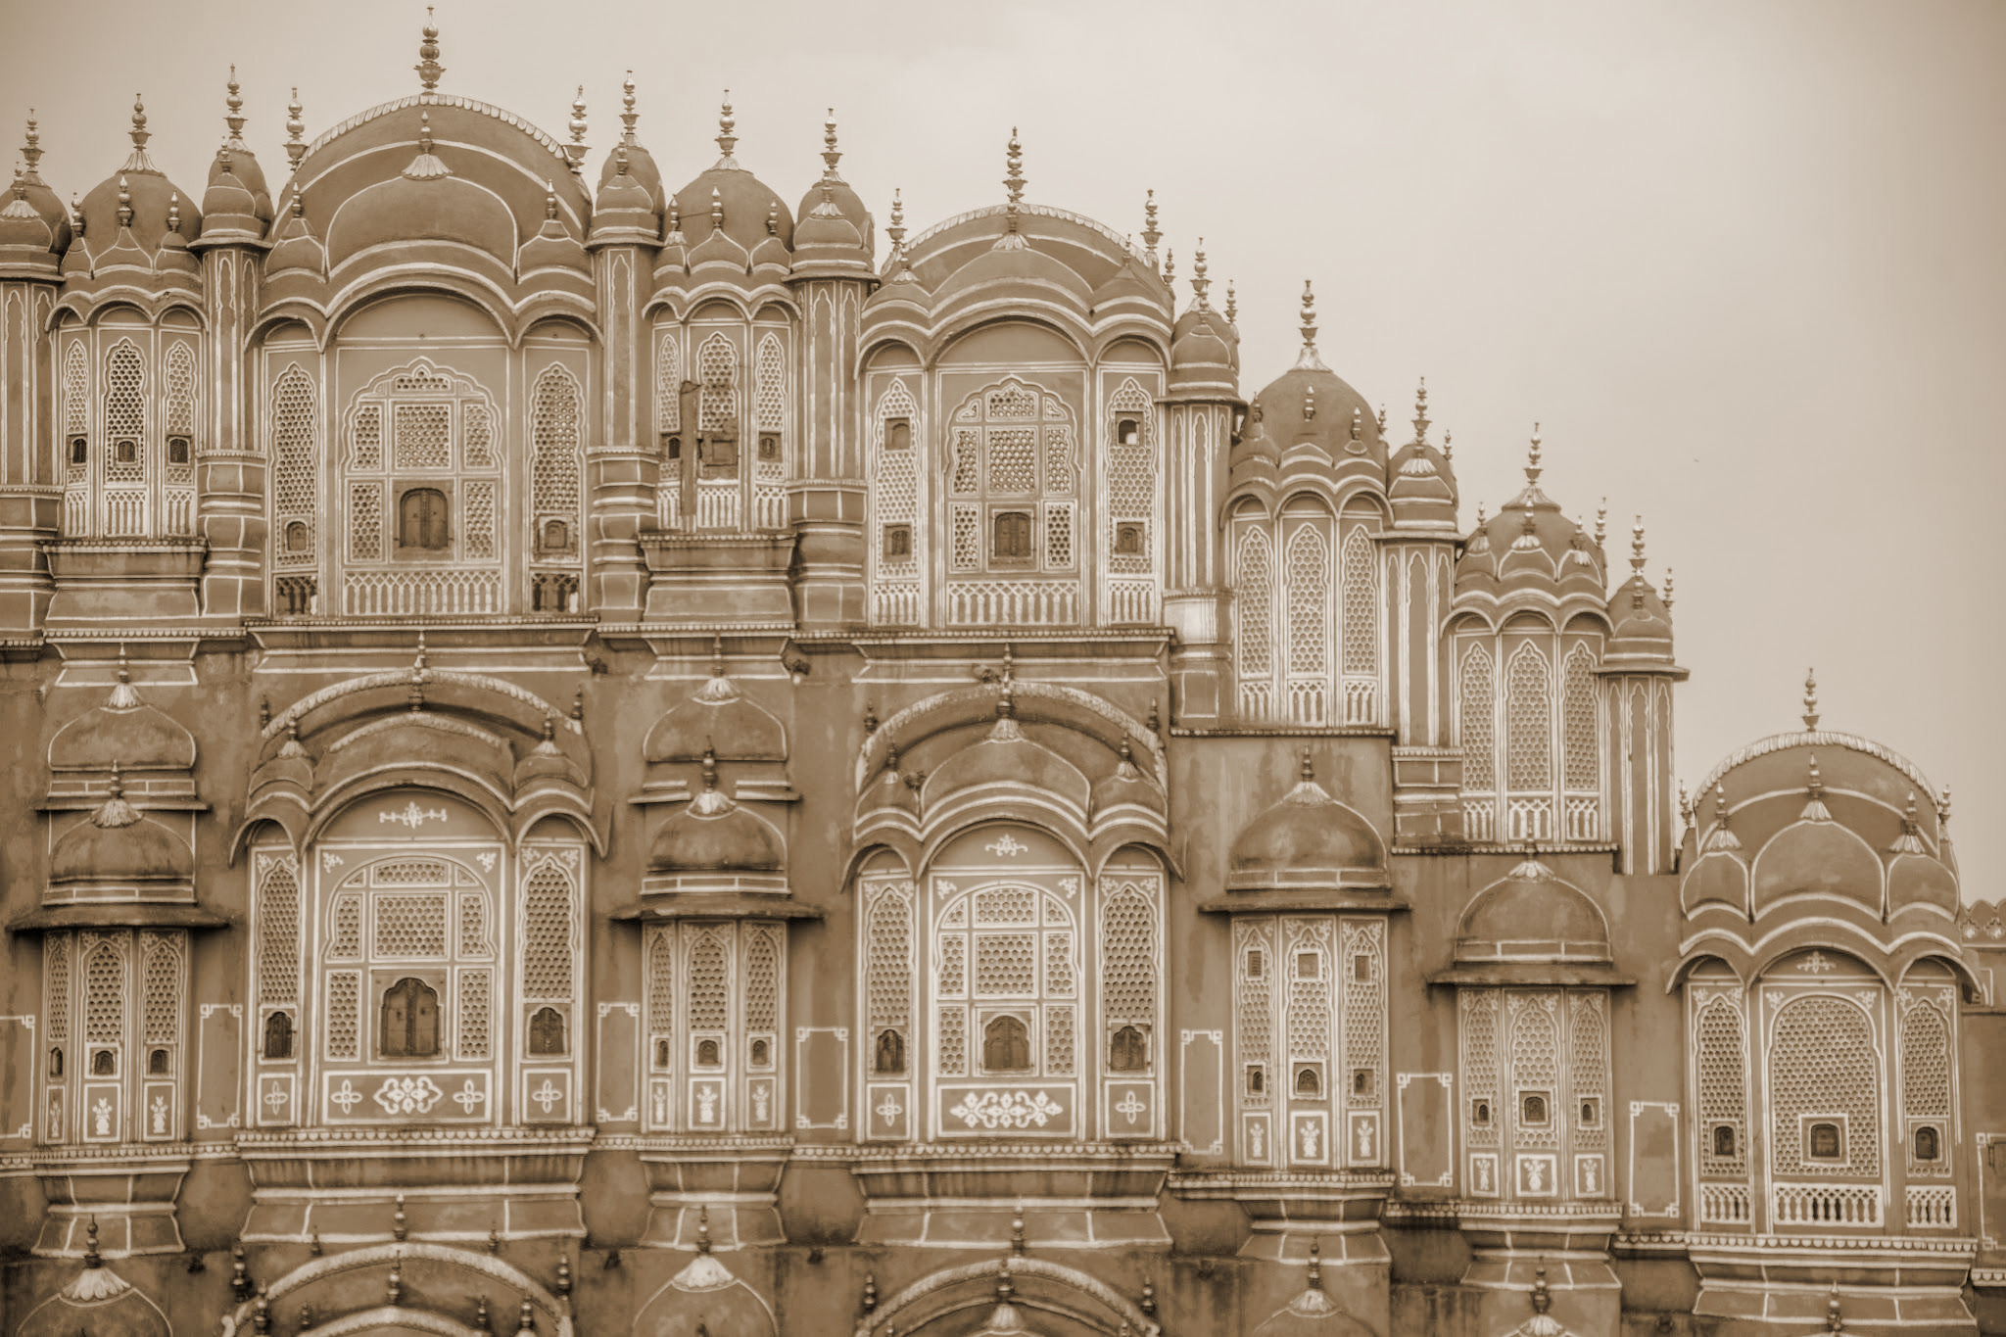
Introduction
India, a land of unparalleled diversity and rich history, stands as a testament to the resilience and brilliance of human civilization. With a heritage that spans thousands of years, India has been a crucible of cultures, religions, and empires, leaving an indelible mark on the tapestry of world history

Slide 5
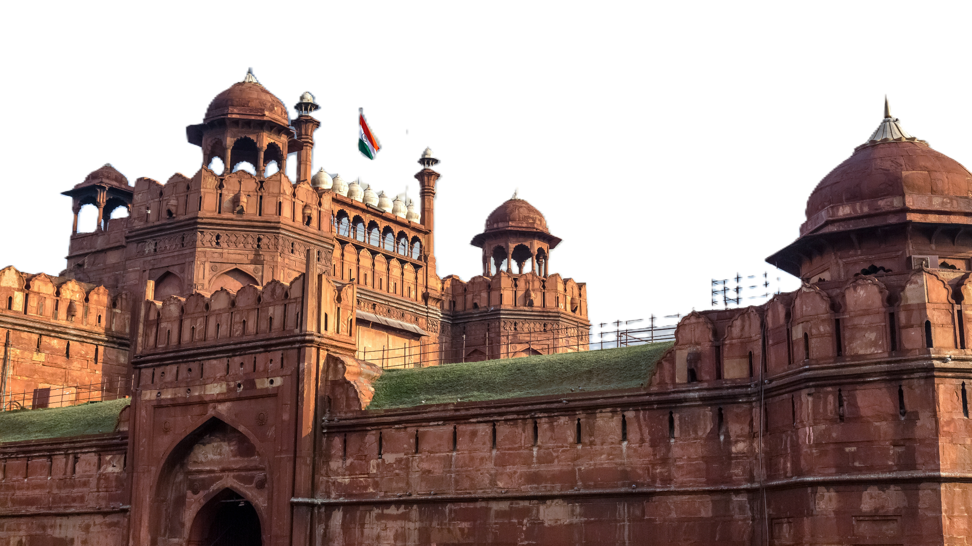
Red Fort (Lal Qila), Delhi
Our journey begins with the iconic Red Fort, or 'Lal Qila,' a jewel in the crown of Delhi. Commissioned by the fifth Mughal Emperor, Shah Jahan, in 1638, the Red Fort served as the main residence of the Mughal emperors for over two centuries, witnessing the zenith of their power and influence.
Constructed as part of Shah Jahan's new capital, Shahjahanabad, the Red Fort stands as a symbol of the Mughal opulence and architectural brilliance during the peak of their rule.

Slide 6
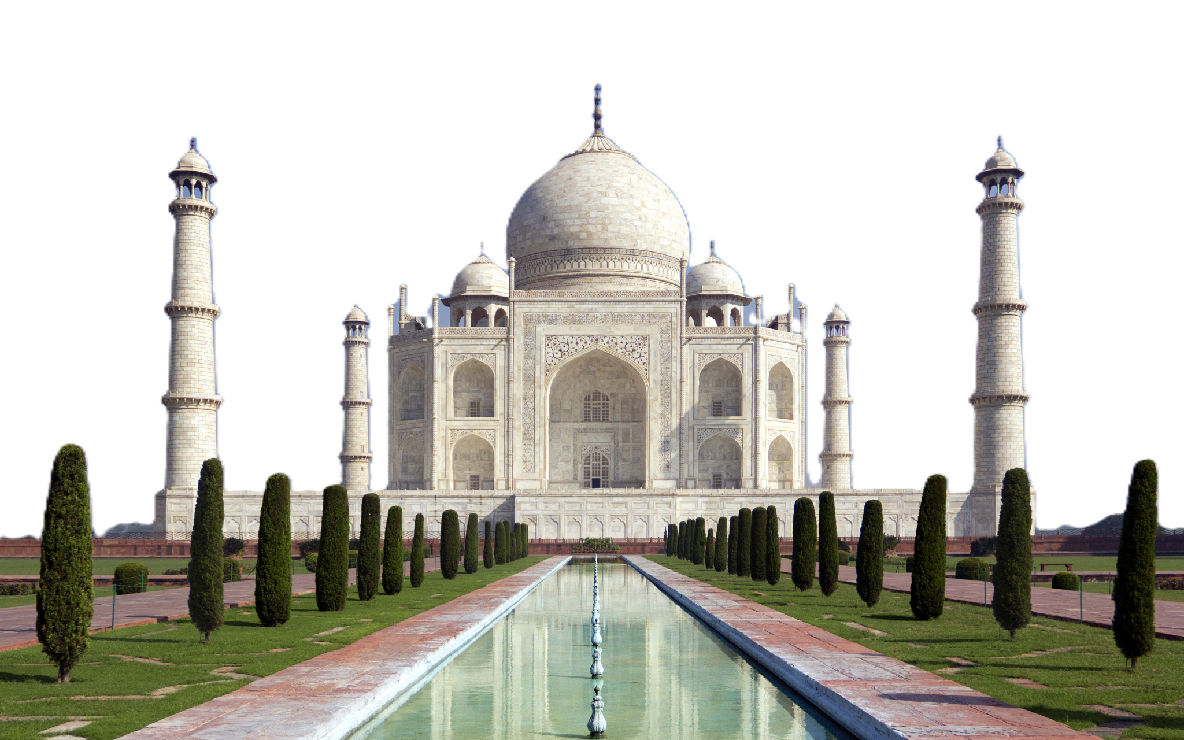
Taj Mahal, Agra
Our next destination in this cultural odyssey is the timeless Taj Mahal, a jewel in the city of Agra. Built by the Mughal Emperor Shah Jahan in memory of his beloved wife Mumtaz Mahal.
Commissioned in the 17th century, the Taj Mahal is an exemplary piece of Mughal architecture, blending Persian, Indian, and Islamic influences. Its iconic white marble facade reflects the changing hues of the sky, creating a breathtaking sight.

Slide 7
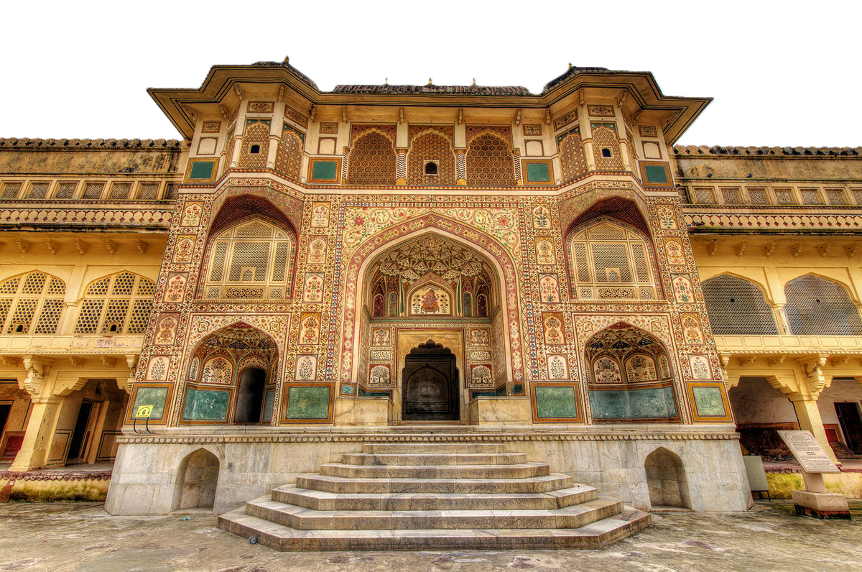
Amer Fort, Rajasthan
Our journey takes us to the majestic Amer Fort, perched on a hilltop overlooking the Pink City of Jaipur in Rajasthan. A fusion of Hindu and Rajput architectural styles, Amer Fort stands as a testament to the valor of the Rajput rulers.
Originally built in the 16th century by Raja Man Singh, Amer Fort was later expanded and renovated by successive rulers, including Raja Jai Singh I.

Slide 8
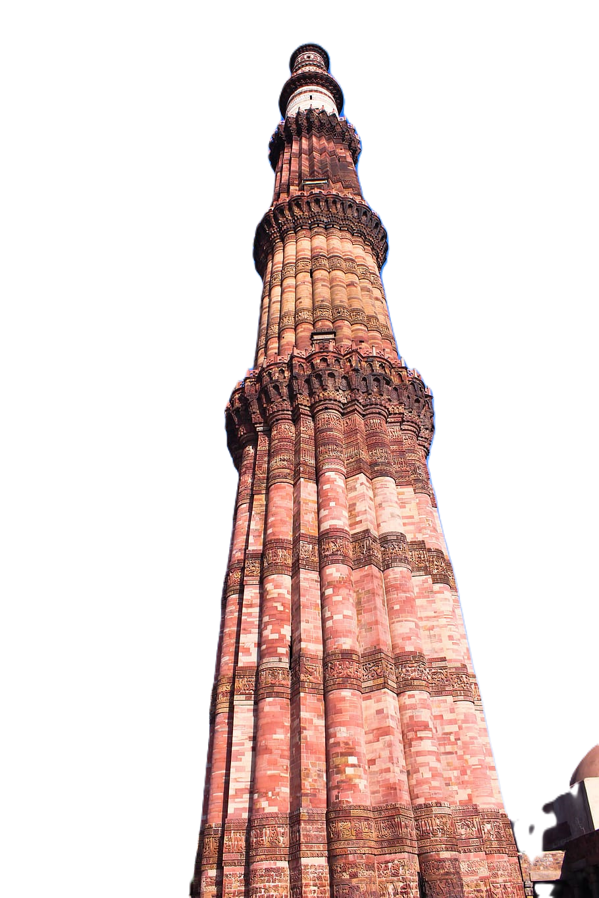
Qutub Minar,
Delhi
Our exploration continues with the soaring Qutub Minar, an iconic symbol of Delhi and a testament to the rich history of India. Built in the early 13th century, the Qutub Minar complex is a UNESCO World Heritage Site.
Commissioned by Qutb-ud-din Aibak and completed by Iltutmish, the Qutub Minar is the tallest brick minaret globally, standing at an impressive height of 73 meters.
The complex also includes various other historically significant structures such as the Quwwat-ul-Islam Mosque, the Iron Pillar of Delhi, and the Alai Darwaza.

Slide 9
Diversity in Architecture
As we traverse the cultural landscape of India through its forts and monuments, one striking aspect emerges the remarkable diversity in architecture. India's history is a tapestry woven with threads of various civilizations, each leaving a distinct imprint on its architectural heritage.
From the intricate carvings of Hindu temples to the grandeur of Mughal palaces, and the elegant simplicity of Islamic structures, India shows a harmonious blend of diverse architectural styles.
The North boasts the grandeur of Mughal architecture seen in the Red Fort and Taj Mahal intricate Dravidian style of temples like the Brihadeshwara Temple.

Slide 10
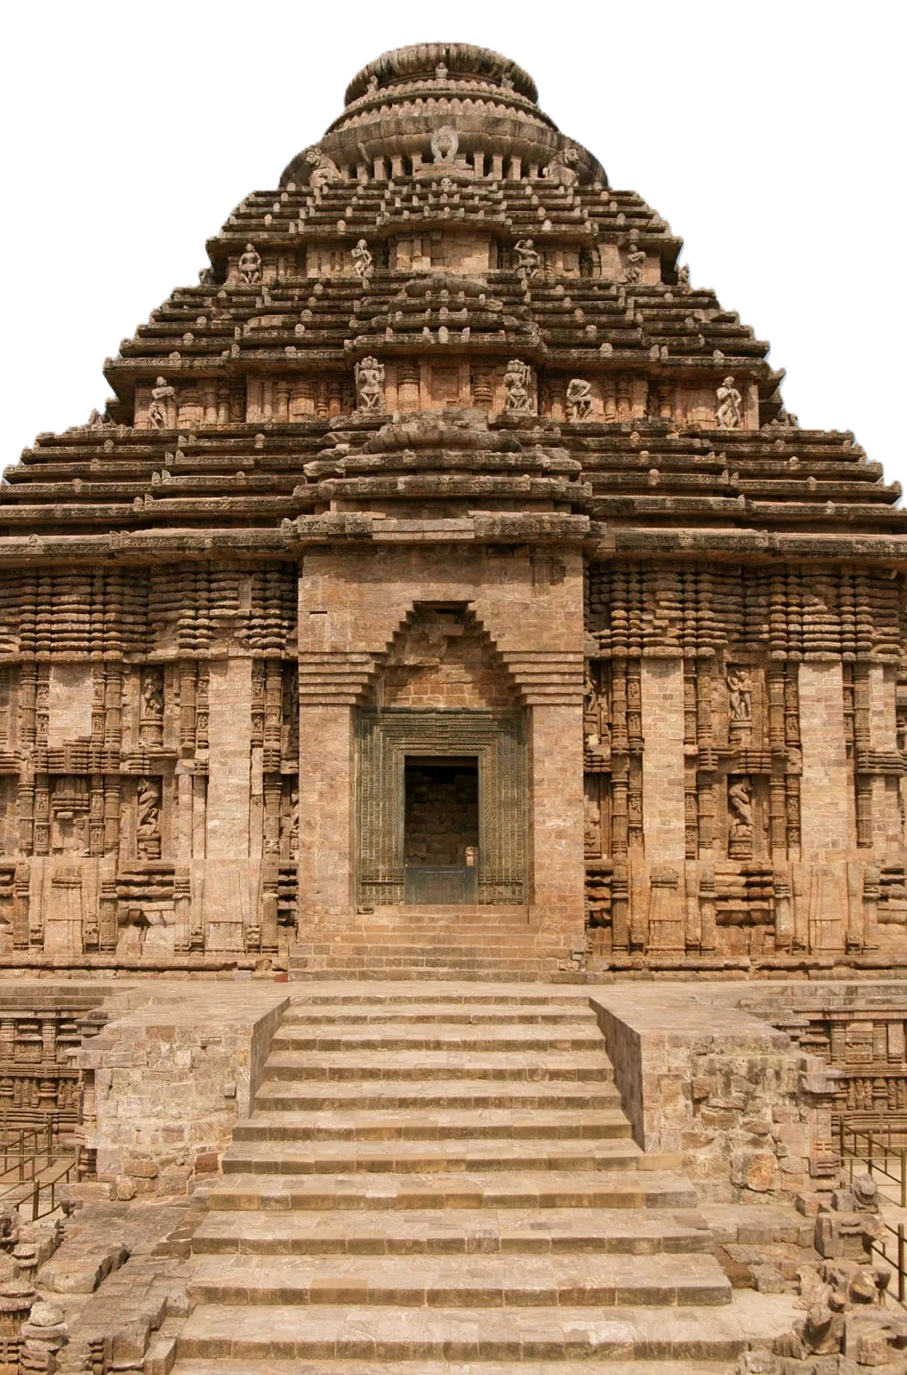
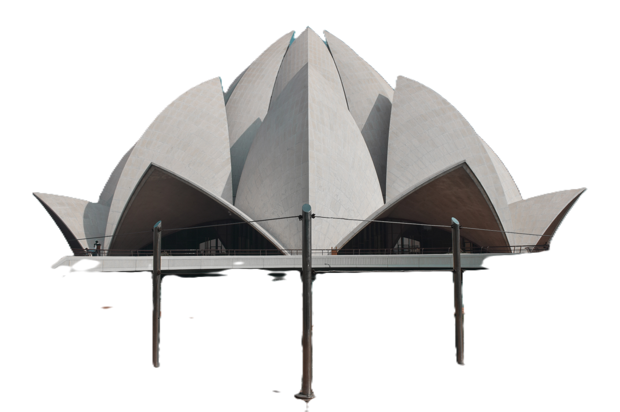
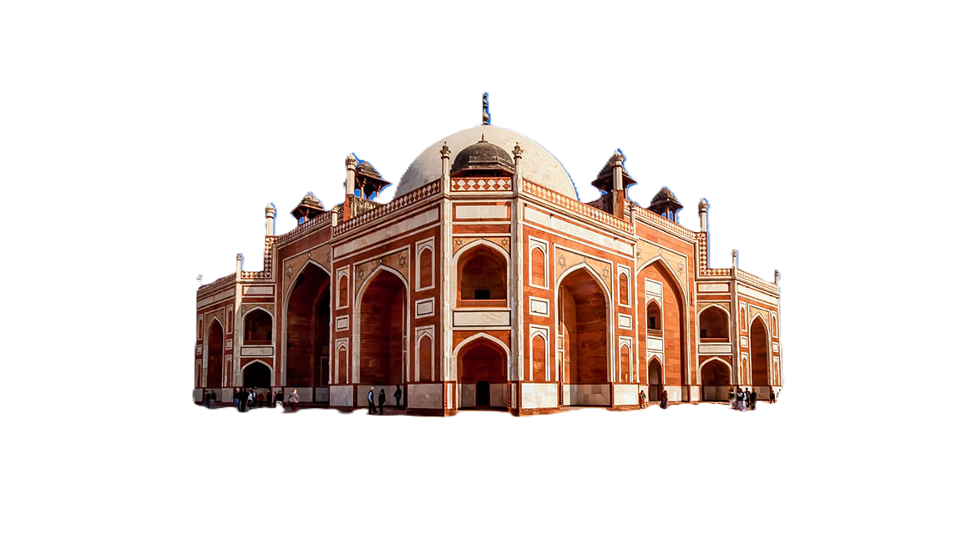
Diverse architecture
of India

Slide 11

UNESCO World Heritage sites in India
India's cultural richness is globally acknowledged through its numerous UNESCO World Heritage Sites. These sites not only stand as testaments to India's historical significance but also serve as windows into the diverse tapestry of its heritage.
India proudly hosts multiple UNESCO World Heritage Sites, each recognized for its outstanding universal value in cultural, natural, or mixed categories.
These sites exemplify the exceptional contributions of Indian civilization to the world's cultural and natural heritage.

Slide 12

Thank you.

